Slide 1




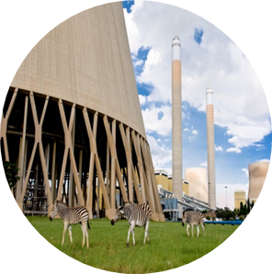

Tutorial D T-pipe junction Transient Thermomechanical FEM model 1
By Ofentse Kgoa
kgoaot@eskom.co.za

Slide 2
Introduction
Background:
It is assumed that Tutorial C is completed.
Objectives:
Open an existing FreeCAD project
Run a transient thermomechanical FEM model
Evaluate and analyze the thermomechanical FEM results
Create a result set vs. time plot
Save the FreeCAD project

Slide 3
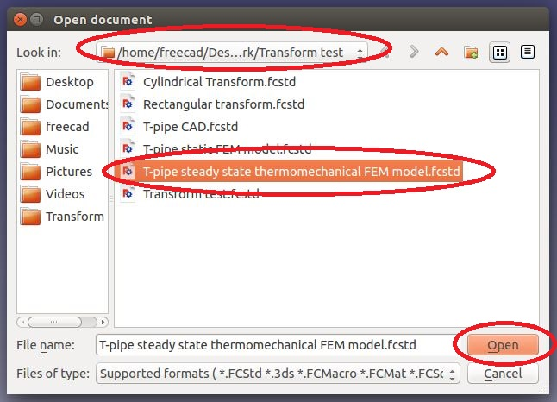
Project start Up
Open an existing project:
To open an existing project, click on <Open a document or import files>
A task dialogue appears, choose the directory the file directory, select the project to be opened and then click on <Open>

Slide 4
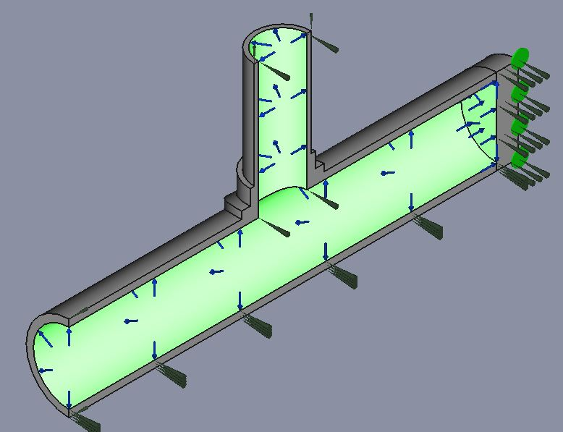
Thermomechanical FEM model (Transient 1) Pre- processing
Notes and assumptions:
The analysis run is a transient analysis. Therefore all variables are time dependent. Transient analysis can be used to simulate plant start-ups and shutdowns.
The T-pipe has the same boundary conditions, material and mesh definition as that of the steady state thermomechanical model. Refer to Tutorial C to obtain all relevant details.
The amount of time required for the T-pipe to reach steady state is to be investigated.

Slide 5
Thermomechanical FEM model (Transient 1) Pre- processing
Notes and assumptions:
The maximum temperature difference over time is to be plotted and investigated.
Stresses over time are to be plotted and investigated for the transient period of the T-pipe.

Slide 6
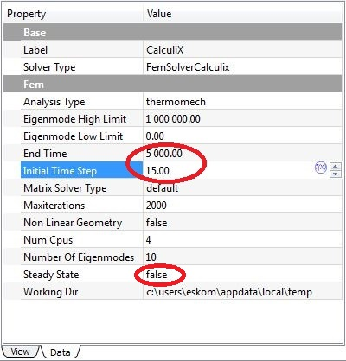
Thermomechanical FEM model (Transient 1) Running the solver
Running the analysis:
The analysis run is a transient analysis. To change the analysis from steady state to transient, click on the CalculiX object in the tree view.
In the property window, the user has different FEM solver settings. Change the “End Time” to 5000 time steps and select “false” under “Steady State”. The larger the number of time steps the longer the computing time.
Choose an Initial Time Step of 15. This value is chosen to reduce the computing time, but it should be chosen with caution as it may affect the accuracy of the results.

Slide 7
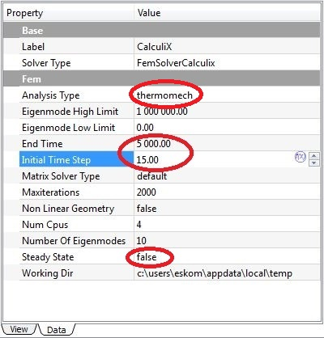
Thermomechanical FEM model (Transient 1) Running the solver
Running the analysis:
The user can also select the number of cpus/cores that should be used by the solver. Enter the number of cpus that are less than or equal to the cpus available from your computer. For instance if the users computer has 6 cpus, the user should choose up to 6 or less cpus.
Now double click on the CalculiX object in the object tree view and run the analysis.

Slide 8
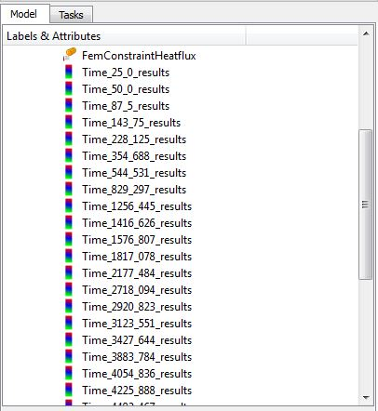
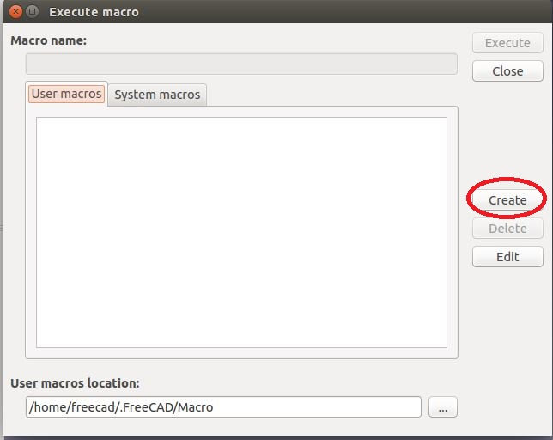
Thermomechanical FEM model (Transient 1) Post-processing
Creating a result set vs. time plot:
A transient analysis produces results for different time steps. The user can view results at any certain time step.
It is impractical to view results at each time step for analysis of the transient period of the T-pipe. A solution is to plot results over time.
To plot results click on <Open dialogue to the execute a recorded macro>.
A task dialogue appears, click on <Create>.
The name of the macro should be “Max Temp Diff”

Slide 9
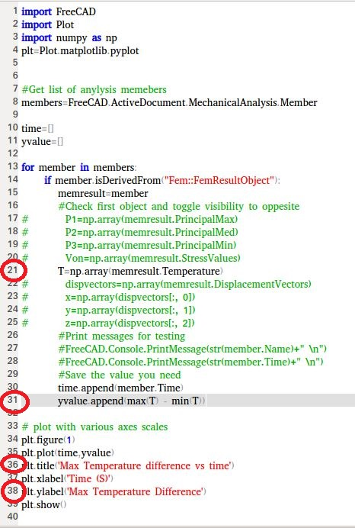
Thermomechanical FEM model (Transient 1) Post-processing
Creating a result set vs. time plot:
An empty macro script appears. Type in the python code displayed in the picture. Ensure that the spacing is the same as that displayed in the picture.
The python code plots the max temperature difference against time.
It is important to note that python coding is case sensitive as well as space sensitive. Meaning that if the is a space where it should not be, the code will not work.
Save the macro.

Slide 10
Thermomechanical FEM model (Transient 1) Post-processing
Creating a result set vs. time plot:
Now create another macro and call it “Max stress”. Use the same python code displayed in the picture.
Remove the “#” on line 20 and add a “#” on line 21. Line 31 should also be changed to plot “Max Von”.
Change the plot titles on lines 36 and 38 accordingly.
Save the macro.

Slide 11
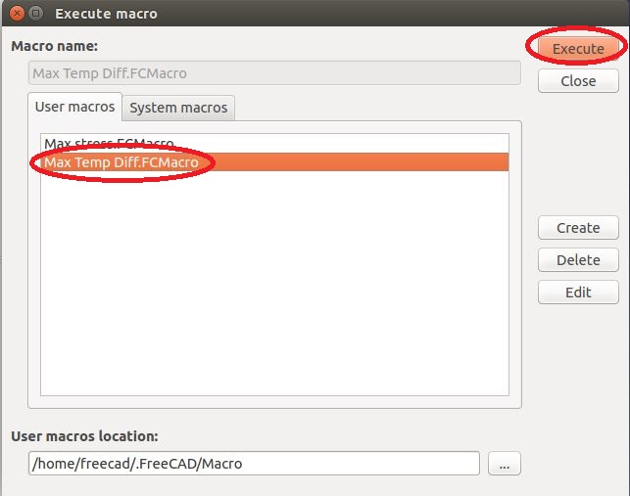
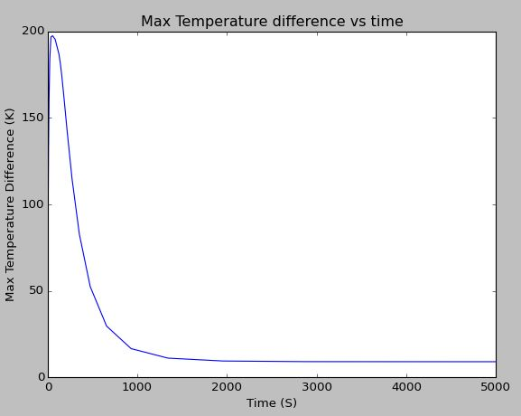
Thermomechanical FEM model (Transient 1) Post-processing
Creating a result set vs. time plot:
Execute the “Max Temp Diff” macro to plot max temperature difference experienced by the T-pipe junction against time.
To plot click on <Open dialogue to the execute a recorded macro>. Select the “Max Temp Diff” macro and click <Execute>.
The plot is depicted in the picture.

Slide 12
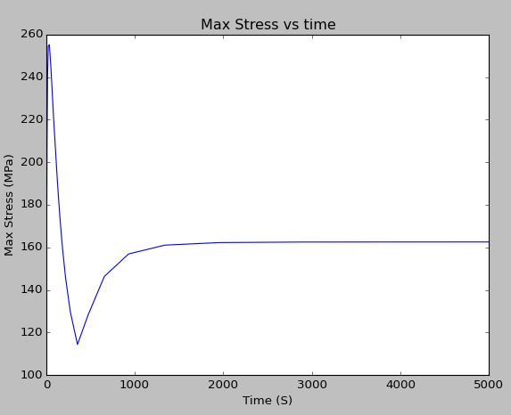
Thermomechanical FEM model (Transient 1) Post-processing
Creating a result set vs. time plot:
Execute the “Max Stress” macro to plot max von mises stress experienced by the T-pipe junction against time.
The plot is depicted in the picture.

Slide 13
Thermomechanical FEM model (Transient 1) Post-processing
Analyzing the results:
From the Max temperature difference plot, it can be seen that the highest temperature gradient of 200 K occurs after the first few seconds.
This is due to the fact that heat convection to the internal surface of the T-pipe by the steam is faster than heat conduction in the T-pipe.
The internal surface of the T-pipe reaches a high temperature faster than all other areas in the T-pipe and this causes a high temperature gradient and therefore a high stresses.

Slide 14
Thermomechanical FEM model (Transient 1) Post-processing
Analyzing the results:
The system reaches steady state after 2000 seconds. The maximum stress experienced by the T-pipe after reaching steady state is 162 MPa.
The maximum von mises stresses is 255 MPa and occurs during the first few seconds of the transient process.
It can be seen that the thermal gradient induced stresses dominate in the first 300 seconds and then stresses induced by the internal pressure start to dominate.

Slide 15
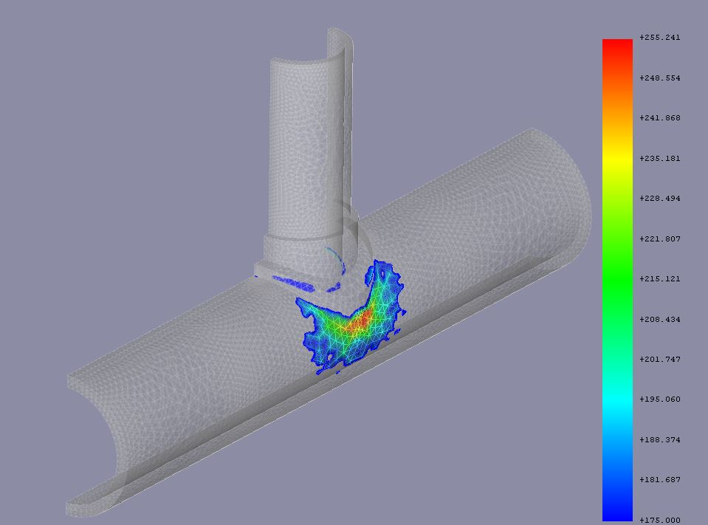
Thermomechanical FEM model (Transient 1) Post-processing
Analyzing the results:
The location of the maximum stress needs to be investigated. Go to the result set at time step 34 (or the time step at which the stress is the highest) and create a post processing scalar clip pipeline to investigate areas in the T-pipe that experience stresses above the proof stress of 175 MPa. (refer to tutorial B for information regarding the proof stress)
The maximum stress experienced by the T-pipe during the transient process is 255 MPa and it occurs on the external surface of the T-pipe.

Slide 16
Thermomechanical FEM model (Transient 1) Post-processing
Concluding remarks:
In order to reduce the temperature gradient experienced by the T-pipe the steam’s temperature should be ramped up slowly to 725 K.
In this particular transient analysis, the behavior of a T-pipe over time was investigated. We have found that the first few seconds of the transient process is critical due to the fact that the heat convection is quicker than heat conduction and this causes high temperature gradients and therefore high stresses which would not have been picked up if only a steady state analysis was performed.

Slide 17

END

